Slide 1
Project Status Report (Midterm)
Team D
Sai Bharadwaj Mukkera
Nithin Reddy Aenugu
Purna Sai Kumar Cheedirala
Tejas Manu Srinivasan
Shreeya Krishna Shiva
10-29-2024, 6:15pm https://github.com/tejas-manu/fox-of-hood

Slide 2
Project Info
Project roles and management:
Team Members and their roles:
Tejas Manu Srinivasan – Dashboard UI and components integration
Sai Bharadwaj Mukkera – Login UI and Database Integration
Nithin Reddy Aenugu – API component and its integration
Purna Sai Kumar Cheedirala – Portfolio management component
Shreeya Krishna Shiva – Database setup, management and integration
Meeting plan:
Twice a week online
Once in-person
Tool used to communicate and assign task:
Zoom/Google meet – for status update calls
Asana – for task allocation (Project Management)

Slide 3
Project Info
Development Process:
Development Process used: Agile
Project is being developed in phases (sprints). After every phase there is a feedback and improvements made.
Project is divided into multiple sprints with their respective milestones.
Adjustments made to the features such as which API to use and so on.
Tools used:
Development:
ReactJS
Node.js
PostgreSQL
Version Control:
GitHub
API:
Alpha Vantage

Slide 4
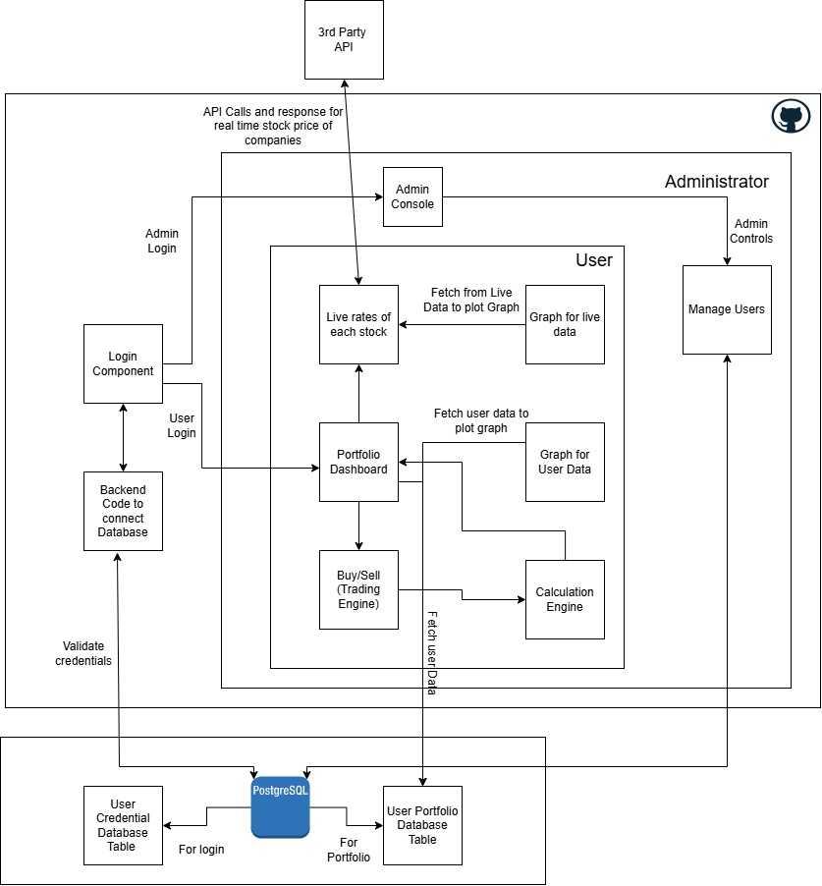
Architecture Diagram
Key Components in the Architecture diagram:
Database and schema
Connection between various components and the database
Calculation engine to quickly update the changes on the Dashboard

Slide 5
Requirement Traceability
Requirement Number: 3.1
Requirement : User Authentication
All existing users will login using username and password.
New users will register using their mail ID and password.
The login page will communicate with the DB using a backend code written in NodeJS.
If the user enters invalid credentials, then it throws an error.
The architecture internals which handle this requirement is:
Login Page
Backend code to connect Database
PostgreSQL (User credentials Table)

Slide 6
Requirement Traceability
Requirement Number: 3.2
Requirement : Stock Market Data Fetching
To fetch live stock data using a third party API and update it every 10 seconds.
As of now, we were able to obtains the API key, but facing challenges with the number of API calls that can be made, as most of them have a limit.
For now, we are able to obtain the real time stock market data using the API and print it on our user dashboard.
The architecture internals which handle this requirement is:
Portfolio dashboard
Live rates of each stock
3rd party API (Alpha Vantage)

Slide 7
Database Schema
User Authentication Table
Column | Data Type | Constraints | Description
user_id | SERIAL | PRIMARY KEY | Unique ID for each user
username | Varchar(50) | Unique, NOT NULL | User’s unique username/email
password | Varchar(50) | NOT NULL | Hashed Password
created_at | TIMESTAMP | DEFAULT CURRENT_TIMESTAMP | Account creation timestamp

Slide 8
Database Schema
User Authentication Table
Column | Data Type | Constraints | Description
user_id | SERIAL | FOREIGN KEY REFERENCES users(user_id) | Links to user who owns the stock
portfolio_id | SERIAL | PRIMARY KEY | Unique ID for each portfolio entry
stock_symbol | VARCHAR(10) | NOT NULL | Ticker symbol of the stock, e.g., "AAPL"
shares | INTEGER | NOT NULL | Number of shares owned
purchase_price | DECIMAL(10, 2) | NOT NULL | Price per share at the time of purchase
purchase_date | TIMESTAMP | DEFAULT CURRENT_TIMESTAMP | Date and time the stock was purchased

Slide 9
Accomplished Work
Work Accomplished so far:
Web-app with a login page and a portfolio page.
Login functionality to authenticate and allow user to enter their dashboard
Portfolio page to have 2 key features:
Live data of company stock and its value
User’s stocks and its current value.
Live data to be fetched using a 3rd party API.
How good is it:
Satisfactory, given the time and requirements.
UI design implemented as expected.
Should be more secure.
Make it more efficient and fast.

Slide 10
Accomplished Work
How Big:
Divided into 5 major components so far.
10hrs a week per person.
Apart from the 5 components, there is a backend code for the DB server.
Language used, platforms and compatibility:
Frontend – ReactJS
Backend integration with DB – NodeJS
Database – postgreSQL
Platforms – Any web browser
Compatibility – compatible with most laptops and desktops
Note: will have more clarity on this if we are able to dockerze and run it on any cloud

Slide 11
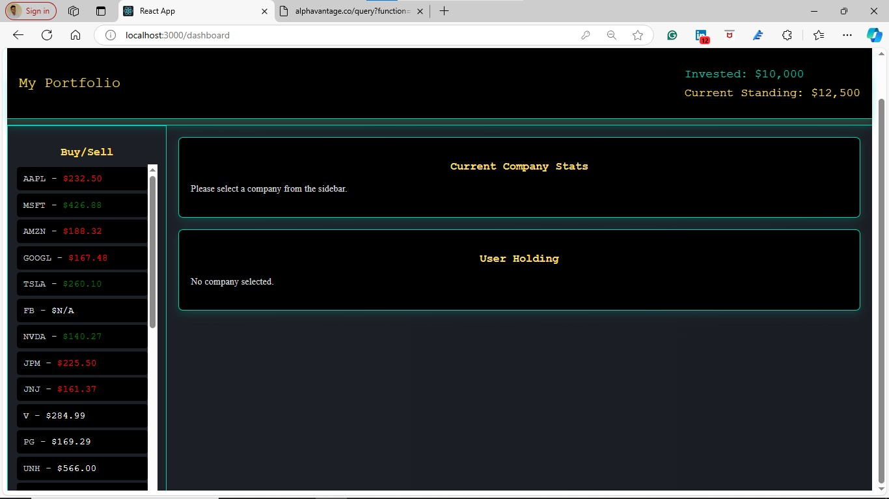
Software In Action
3 Key Features:
Login functionality
Integration of API with the Web app
User Interface with the placeholders for upcoming features

Slide 12
Lessons Learned
What went right ?
Integration of DB and API with the dashboard. – prone to giving problems
UI design – alignment and placement of the components worked better than expected
What went wrong ?
3rd party API became challenging due to the limitation on the number of calls per day.
Web-app started slowing down as we started implementing additional features into it.
What would we do differently ?
Start implementation early.
Creating a pipeline and develop components in a particular order. (basic to complex)

Slide 13
DEMO

